Slide 1
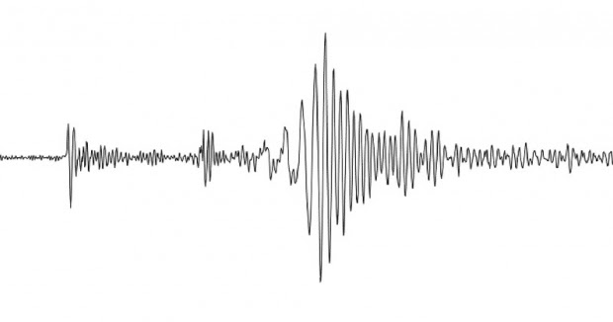
It’s All My Fault!
California Earthquakes: Lesson 5
This Photo by Unknown Author is licensed under CC BY-NC-ND

Slide 2
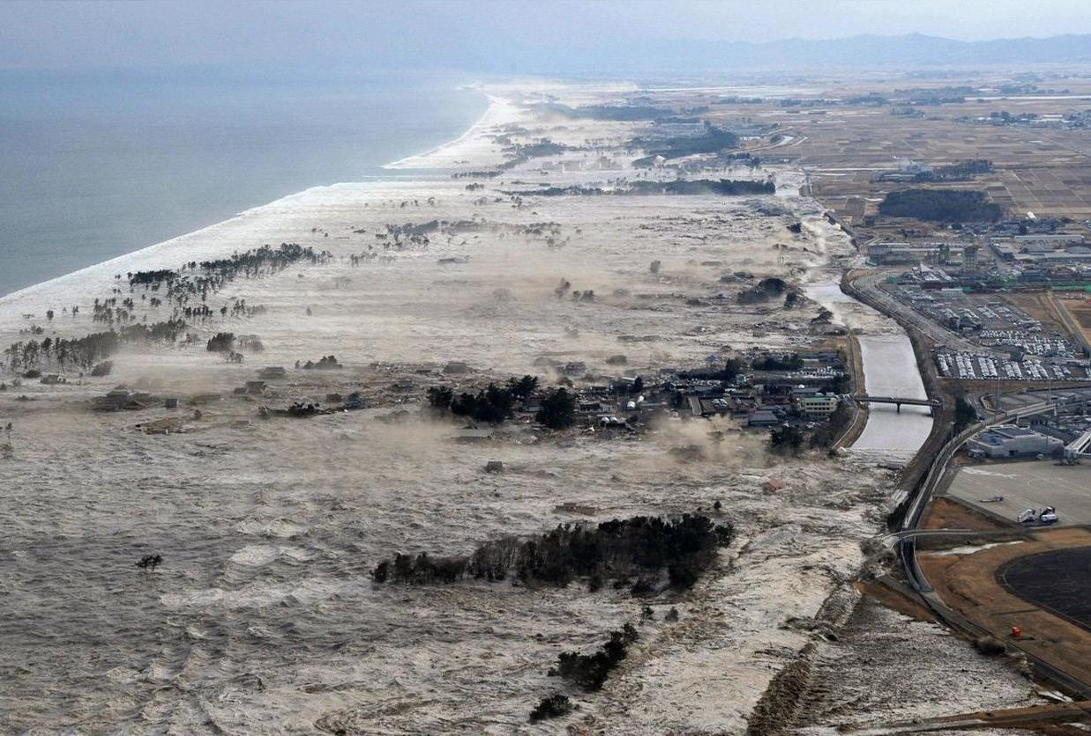
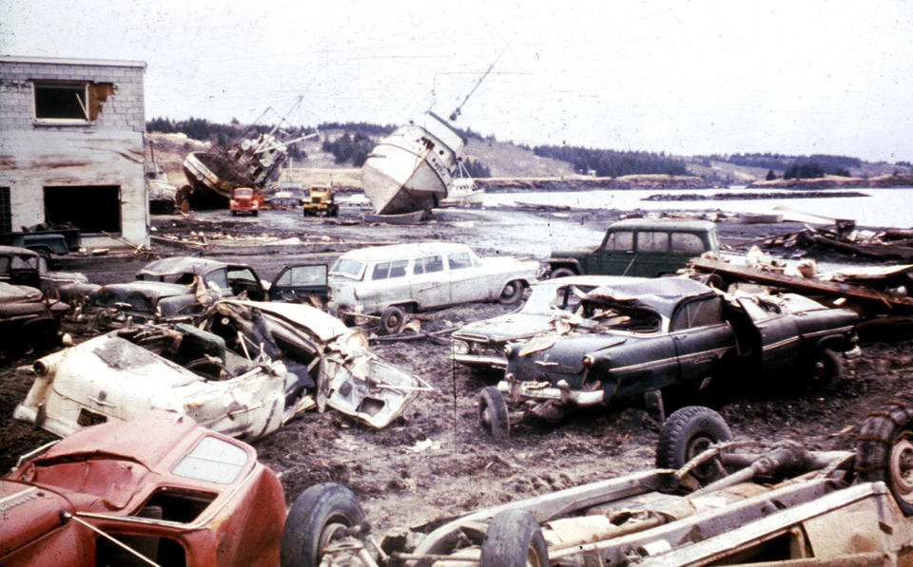
What happened here?
This Photo by Unknown Author is licensed under CC BY-NC
This Photo by Unknown Author is licensed under CC BY-NC-ND

Slide 3
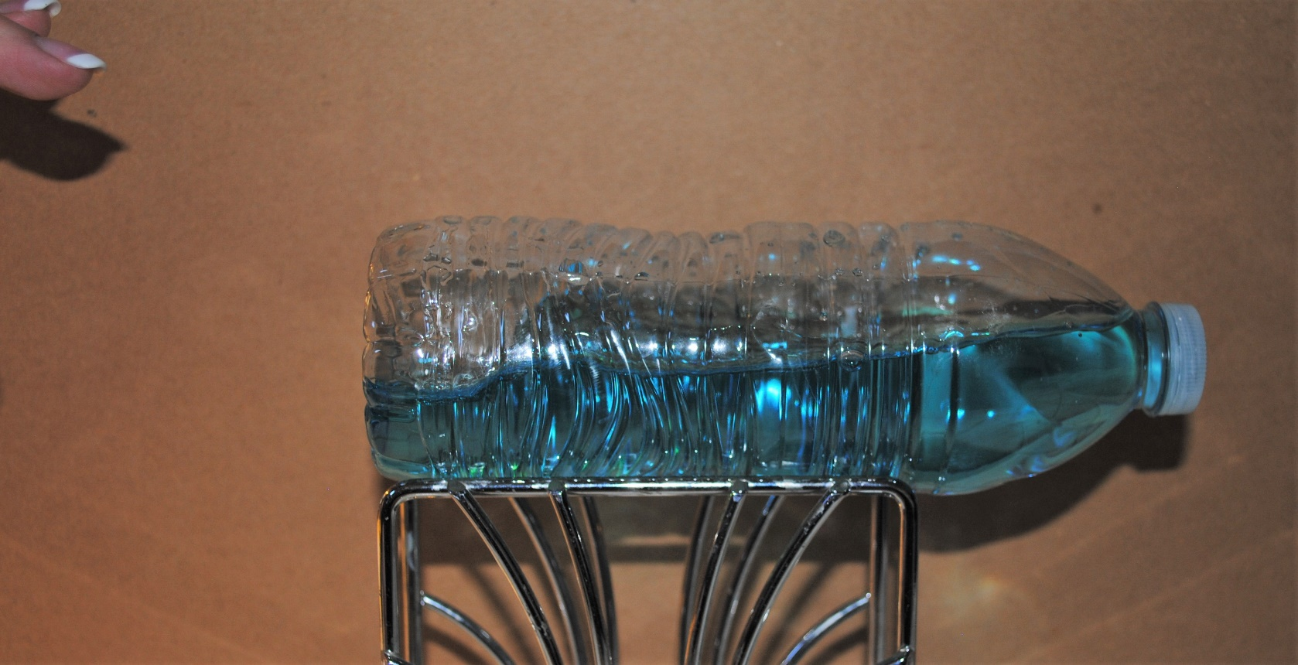
Let’s make some waves!
What patterns do you see in the motion of the water?
Draw two pictures of your experiment: Before and after. Use arrows to describe motion of the water.

Slide 4
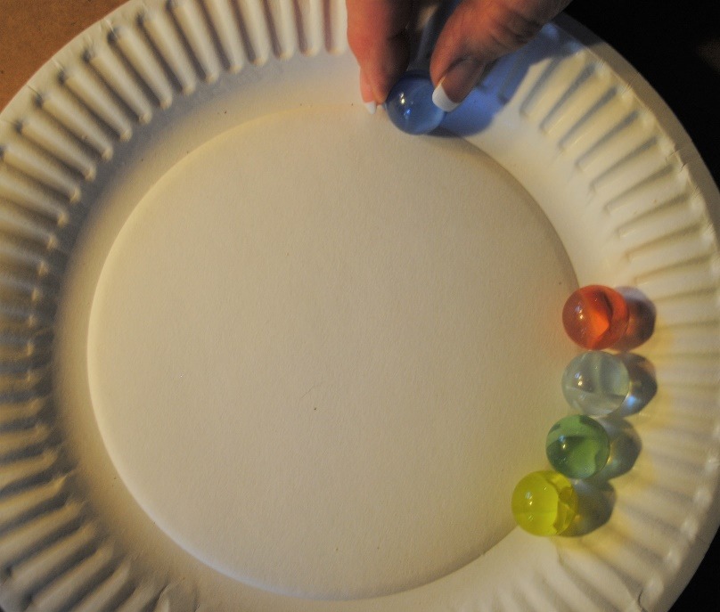
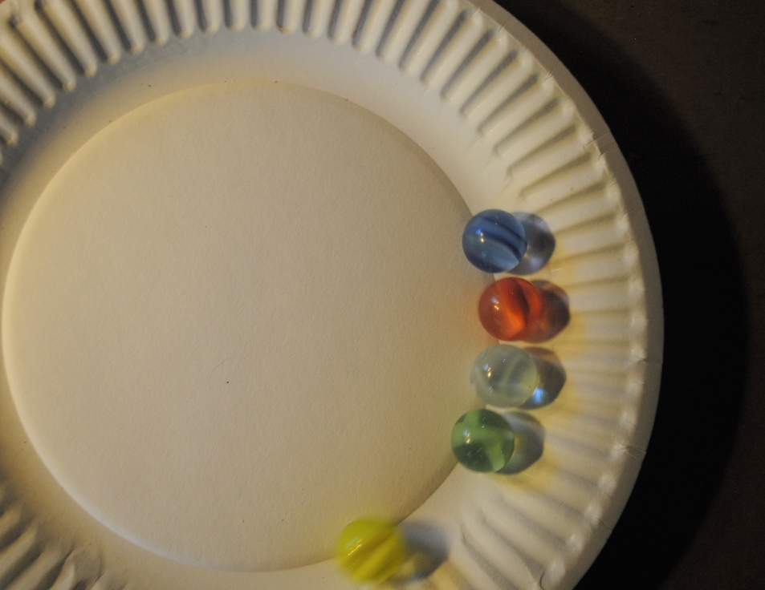
How does wave energy work?
Line up 4 marbles. Use a fifth marble to hit the first marble in the line. What happens to the last marble?
How might your observations apply to wave energy?

Slide 5
Can you see the direction of motion in this wave?
This Photo by Unknown Author is licensed under CC BY-SA
What shape will it make?

Slide 6
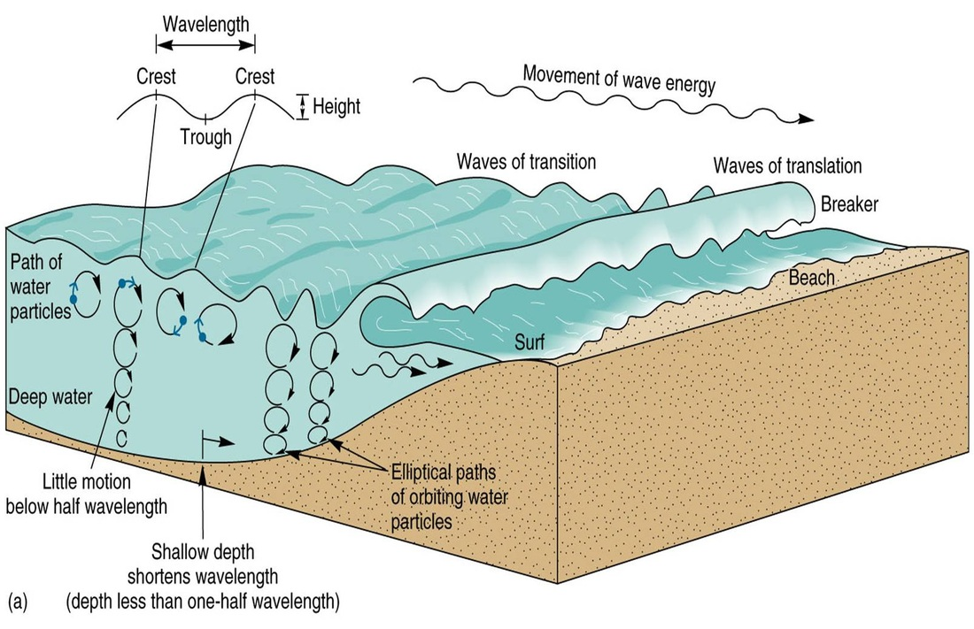
Water particles move in a circular motion to move wave energy.
This Photo by Unknown Author is licensed under CC BY-NC-SA

Slide 7
What is a tsunami?
A tsunami is a wave, or series of waves, generated by an earthquake, landslide, volcanic eruption, or even large meteor hitting the ocean.
An enormous wave is created that often causes a large amount of damage near the beach area.

Slide 8
Are we in a tsunami hazard area?
Why or why not?
The California Geological Survey has created maps to show which areas could be affected by a tsunami. Click on the link below, select the area by county, then select a specific map. The red line will show you how far a tsunami will flood a certain area.
http://www.conservation.ca.gov/cgs/geologic_hazards/Tsunami/Inundation_Maps/Pages/Index.aspx#Interactive

Slide 9
Tsunamis: Know What to Do! - View the Emmy Award winning animated video produced by the San Diego County Office of Emergency Services.
This Photo by Unknown Author is licensed under CC BY-ND

Slide 10
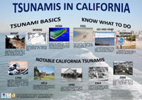
Create an infographic or public service announcement to share with the class that describes a tsunami and what people should do if there is a warning?

Slide 11
Changes to Earth can be fast or slow.
Earthquakes are a result of slow movement by the tectonic plates that creates stress at faults. Faults can slip suddenly causing fast movement in the earth. Results of earthquakes can be fast. They include landslides, liquefaction and tsunamis.

Slide 12
conservation.ca.gov
maps.conservation.ca.gov

